Slide 1
DATA SCIENCE FOR ECONOMISTS
ECON 220 LAB
Jafet Baca-Obando
Week 7, Data visualization – 10/10/2025

Slide 2
Outline
01 | Scatterplots with seaborn
02 | Bar charts

Slide 3
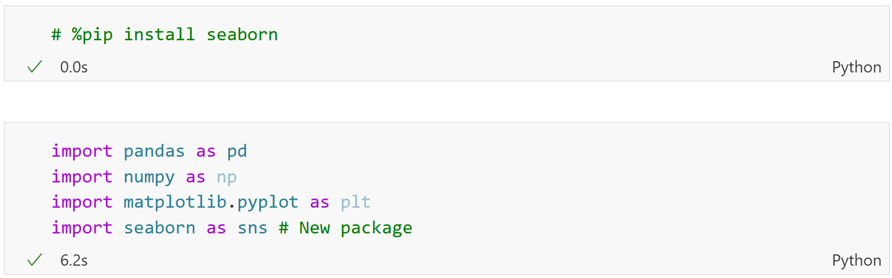
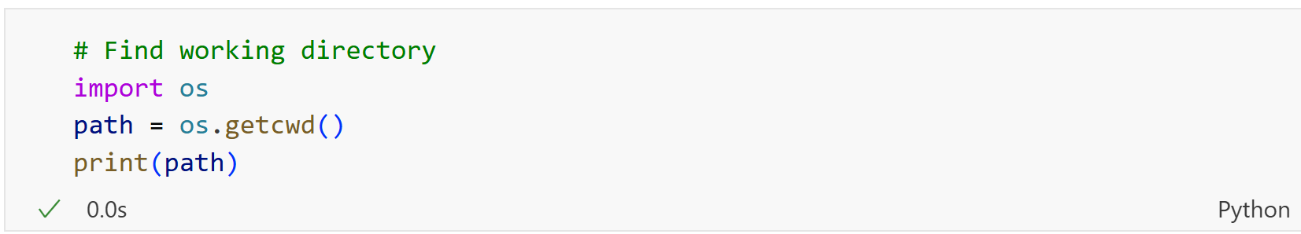
Importing required libraries and dataset

Slide 4
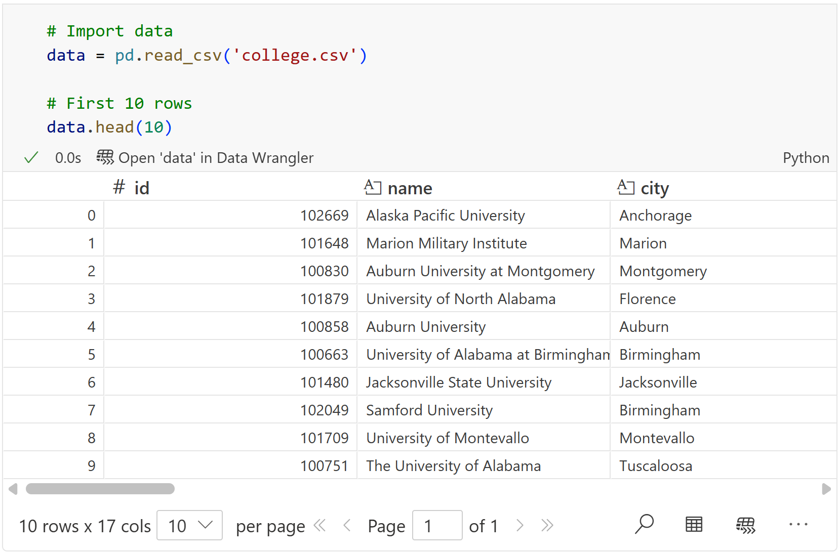
Load the data

Slide 5
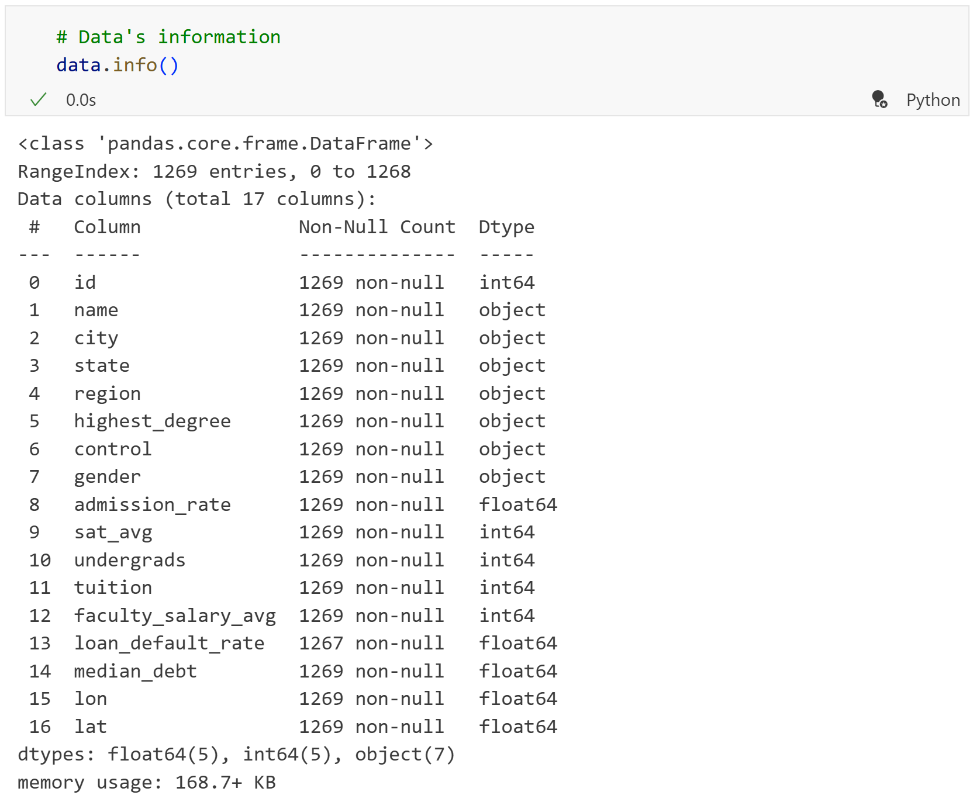
Do the data types make sense?

Slide 6
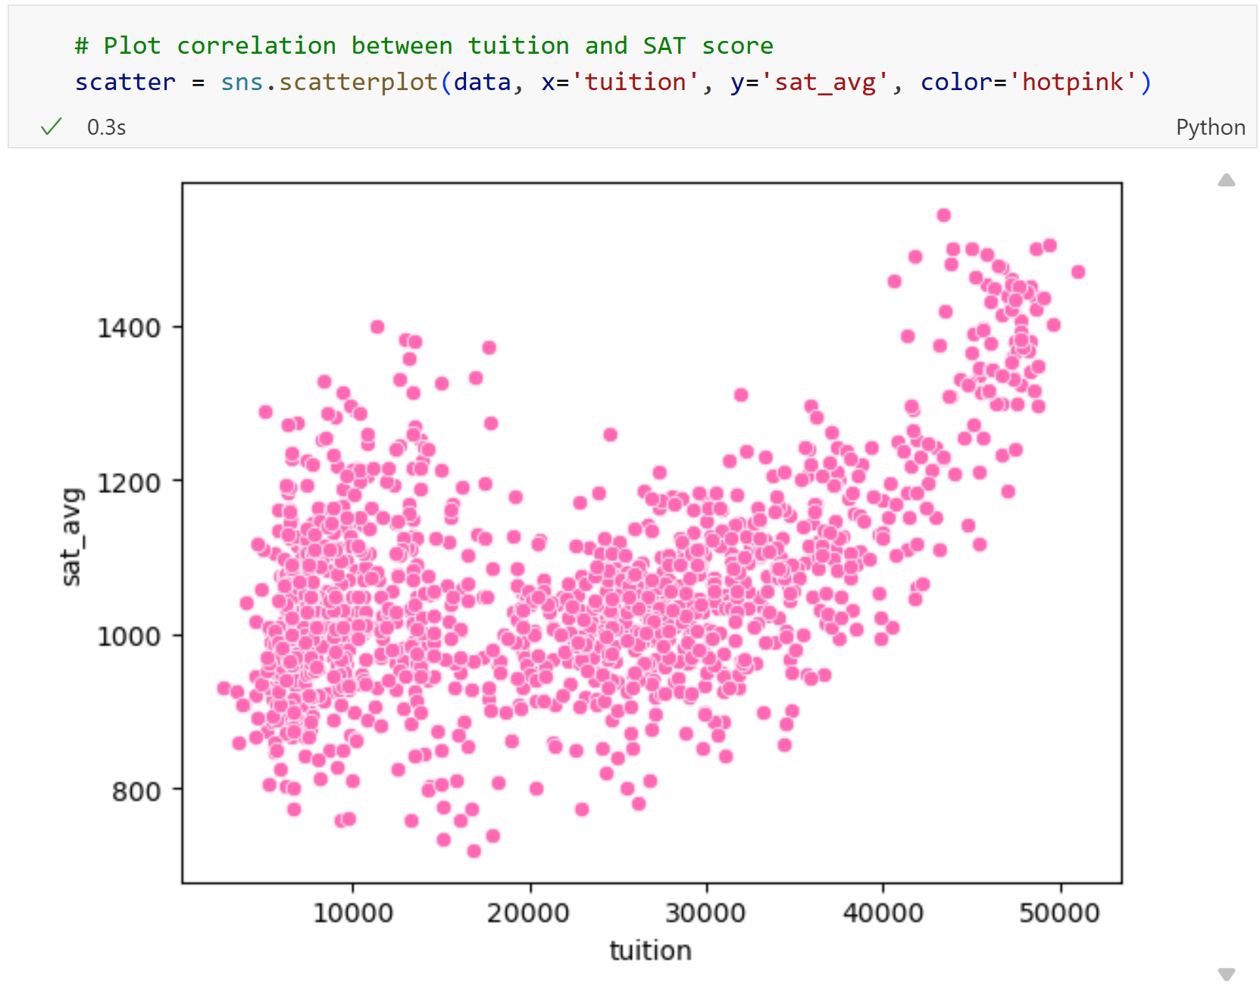
Scatterplots with seaborn

Slide 7
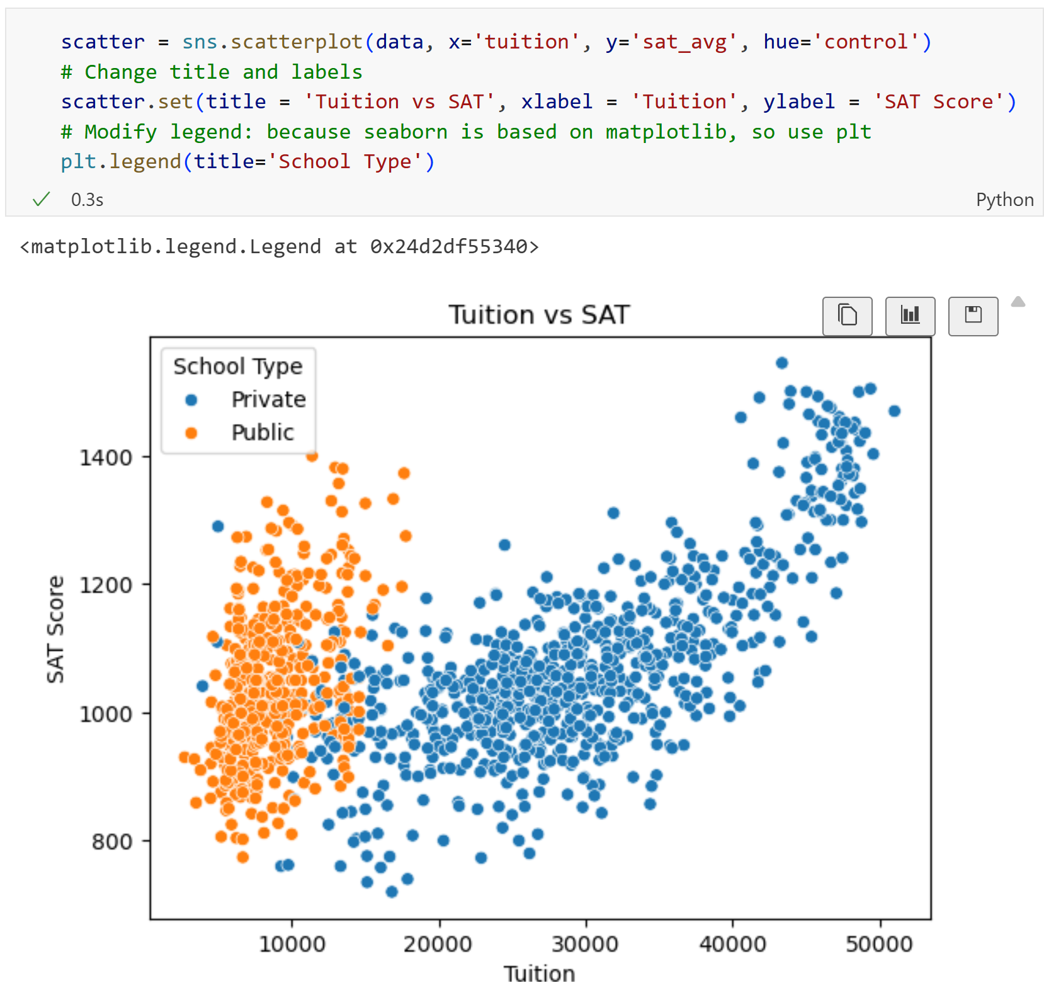
Tuition versus SAT by school type

Slide 8
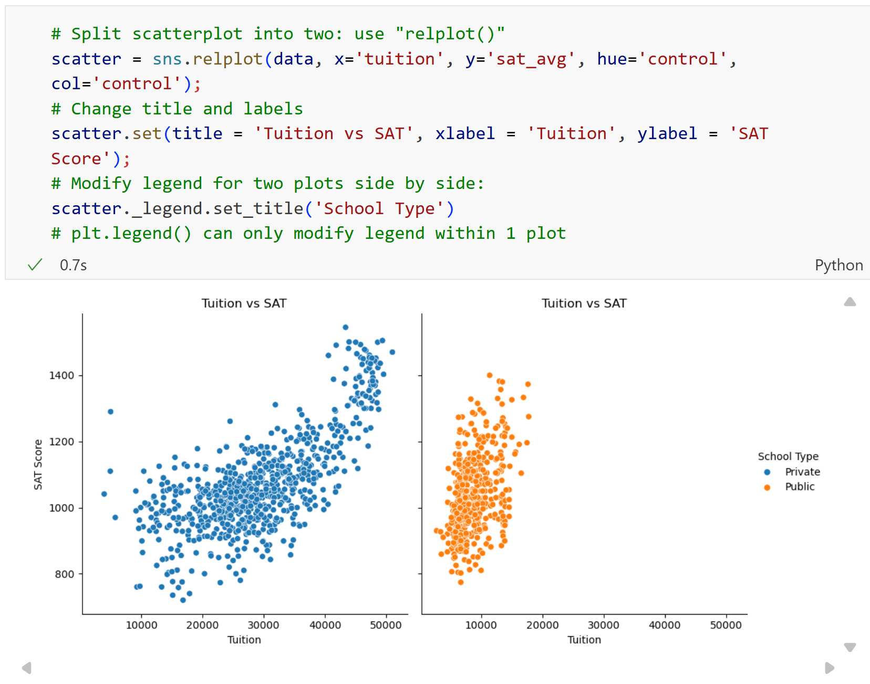
Facet grid

Slide 9
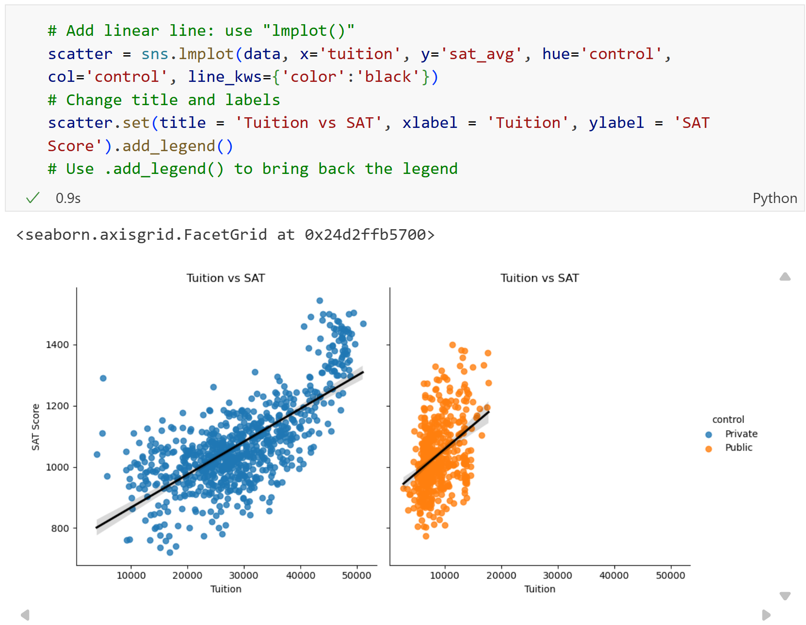
Trend lines

Slide 10
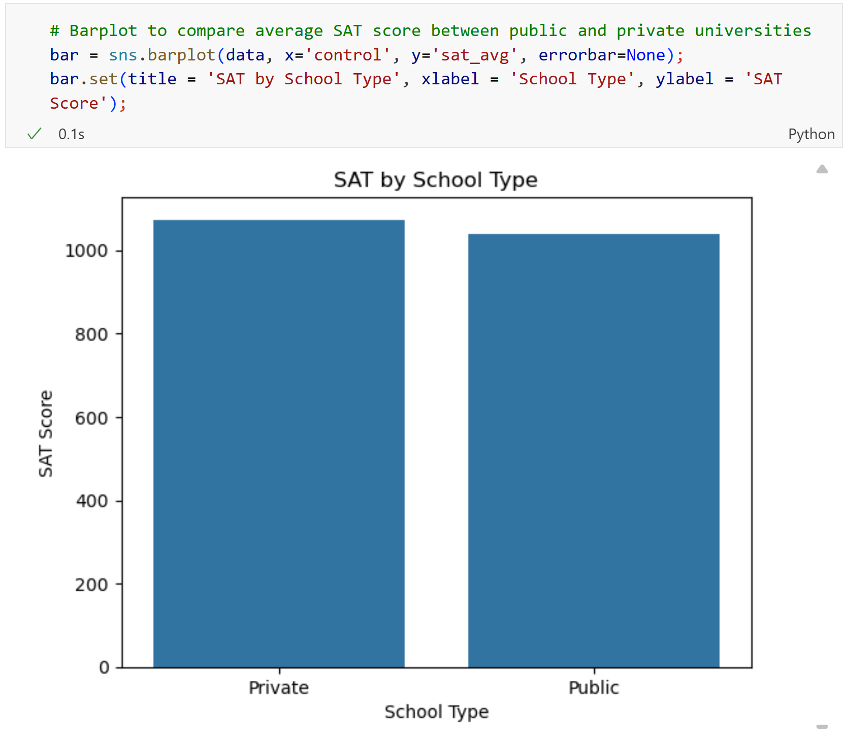
Bar charts with seaborn

Slide 11
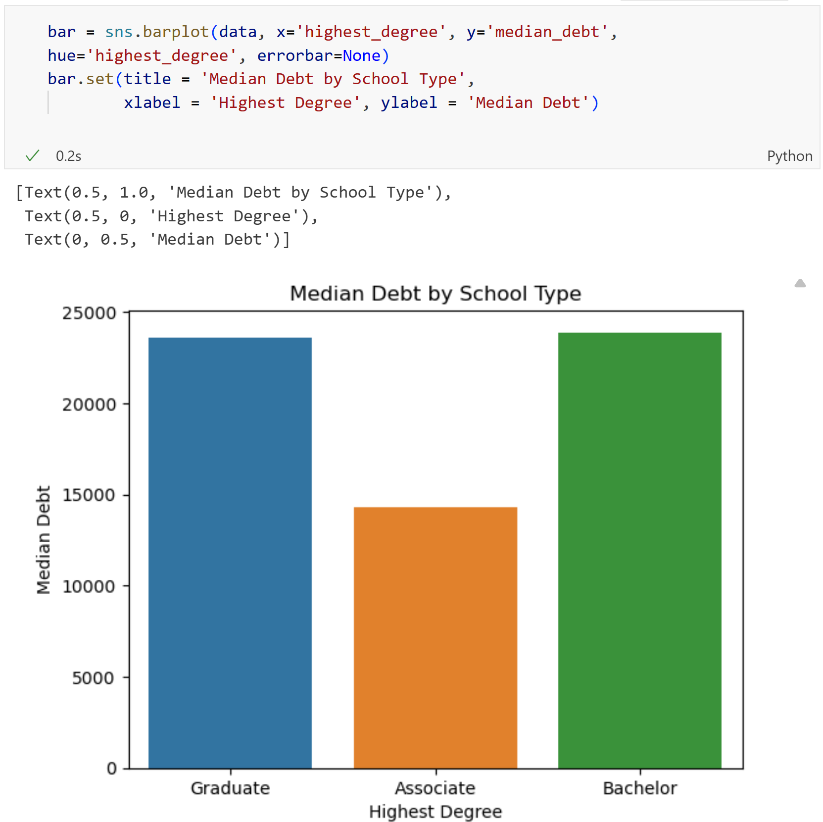
Bar charts with seaborn

Slide 12
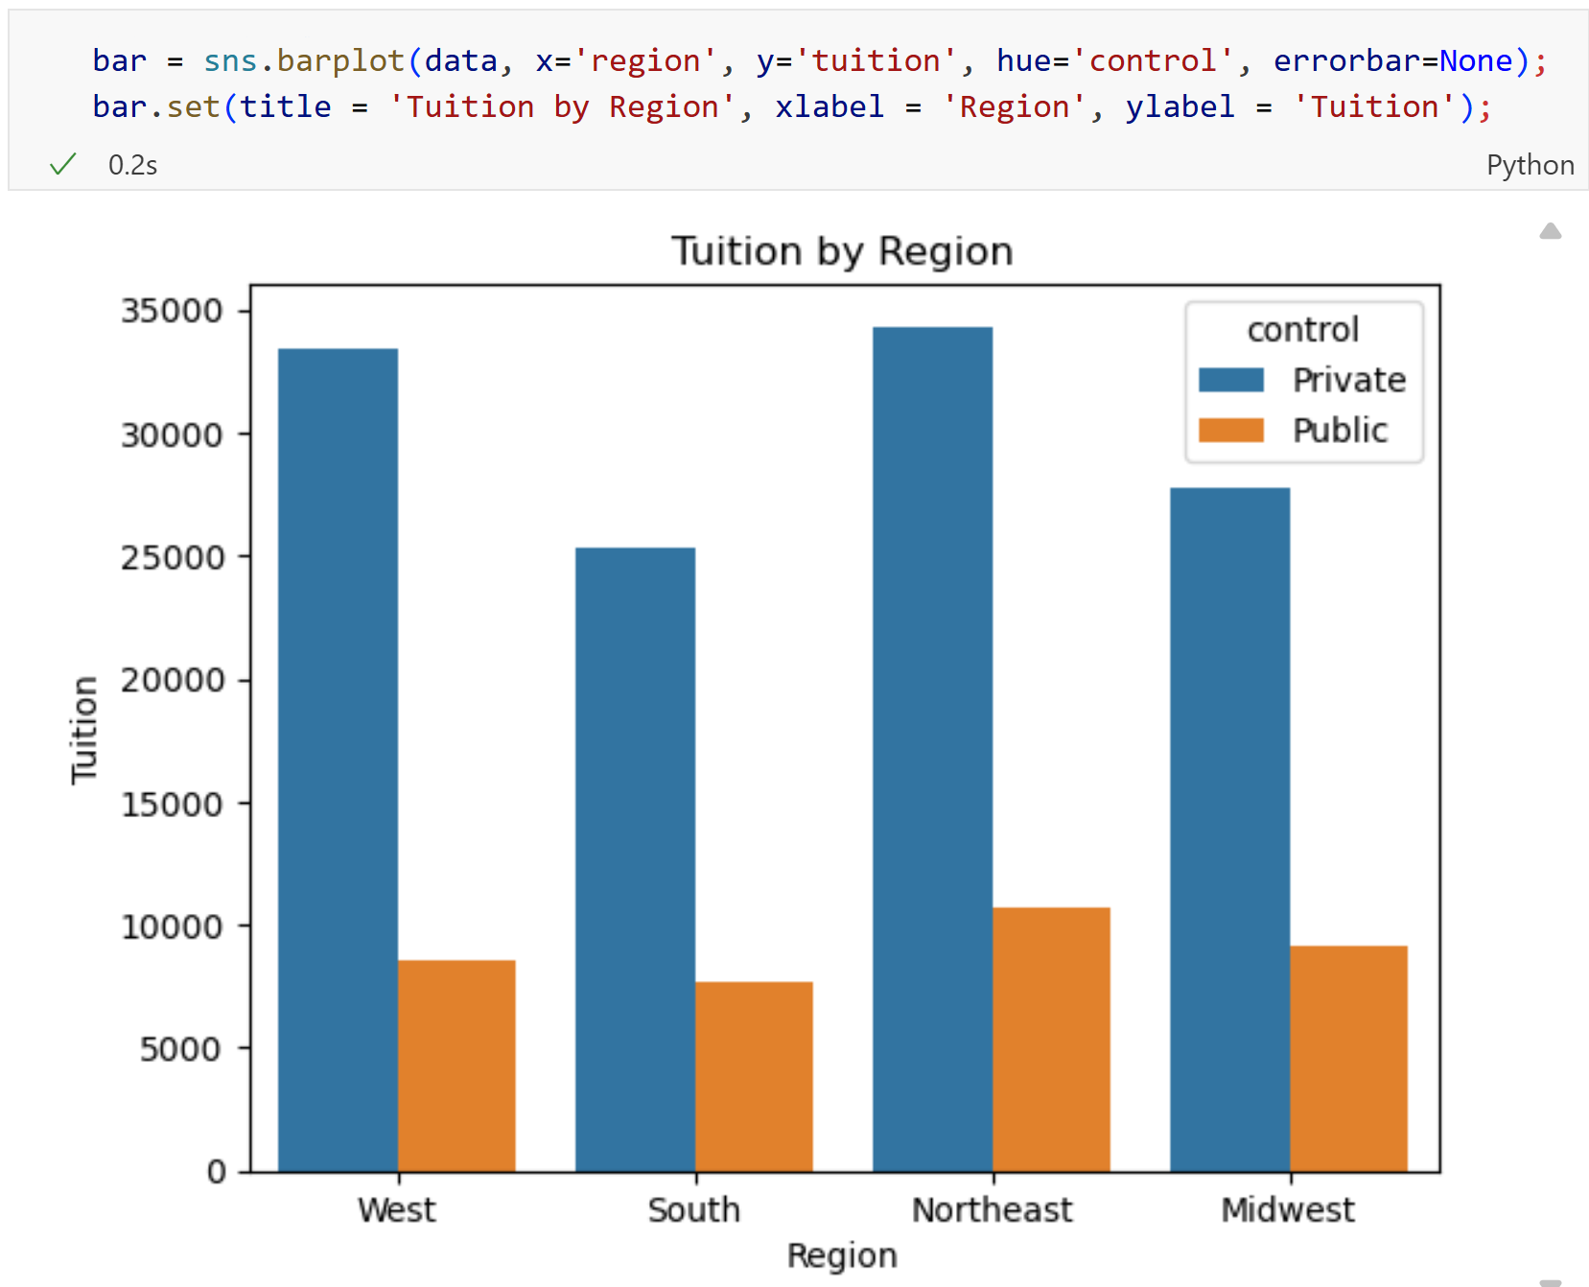
Bar charts with seaborn

Slide 13
Recap
We created scatterplots and bar plots using seaborn.
We analyzed correlations in college data.

Slide 14
To-do list
Complete Data Exercise 4
  Upload Jupyter notebook (.ipynb file) and HTML file on October 12
Complete Data Exercise 5
  Upload Jupyter notebook (.ipynb file) and HTML file on October 19

